Slide 1
.NET
Beginner Level (Session 8)

Slide 2
Overview
Recap last session
Authentication
Authorization

Slide 3
Last Session
Transactions
Extracting Business Logic into Services
Code Reusability

Slide 4
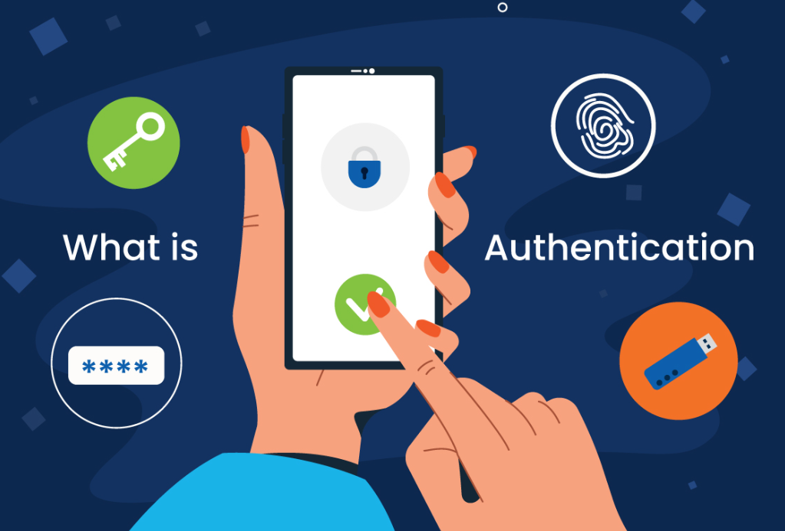
Authentication
Process of verifying the identity of a user or system
To ensure that the person or system accessing a resource is who they claim to be
Key Components
Authentication Factors
Identity
Credentials
Authentication Process

Slide 5
Authentication Factors
Something You Know
Knowledge-based credentials (e.g., passwords, PINs)
Something You Have
Possession-based credentials (e.g., security tokens, smart cards)
Something You Are
Inherence-based credentials (e.g., fingerprints, facial recognition)

Slide 6
Identity
Identity refers to the unique identifier of a user or entity in a system. This could be a username, email address, or another unique attribute

Slide 7
Credentials
Credentials are the information a user provides to prove their identity. These are often secret and known only to the user and the system
Types of Credentials
Password
PIN
Biometrics
Security Tokens

Slide 8
Authentication Process
User Request
Credential Validation
Access Granted/Denied

Slide 9
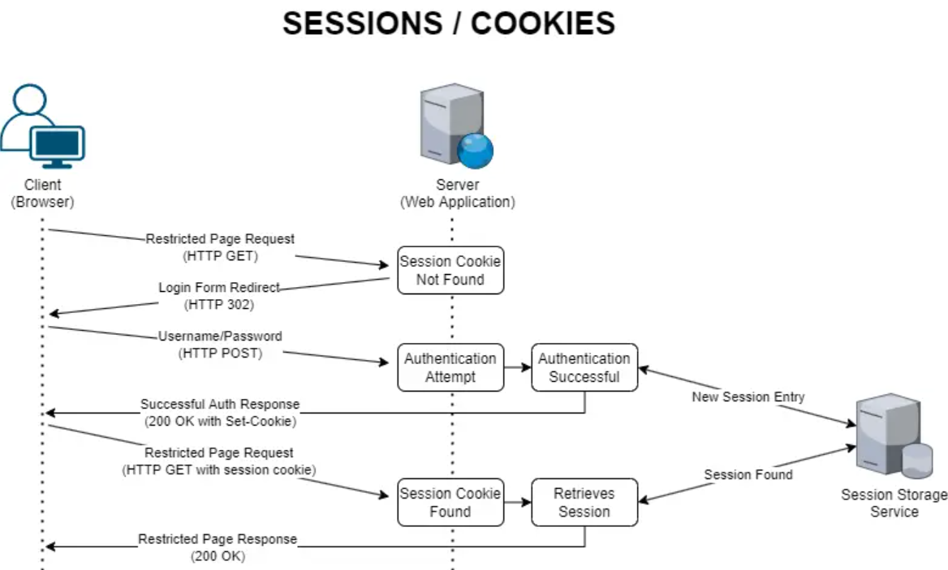

Slide 10
Authentication Methods
Password-Based Authentication
Most common method using passwords
Token-Based Authentication
Uses tokens (e.g., JWT) for verifying identity
Biometric Authentication
Uses unique biological traits
Certificate-Based Authentication
Uses digital certificates to establish identity
OAuth and OpenID Connect
Protocols for secure, third-party authentication

Slide 11
Types of Authentication
Single-Factor Authentication (SFA)
Uses one type of credential, typically a password
Two-Factor Authentication (2FA)
Combines two different factors, such as a password and a mobile verification code
Multi-Factor Authentication (MFA)
Uses two or more factors to increase security

Slide 12
Token-Based Authentication
Uses tokens instead of traditional credentials
JWT (JSON Web Token)
A compact, URL-safe token format used for secure transmission of claims.
Stateless, scalable, and widely supported
Requires secure storage and transmission of tokens

Slide 13
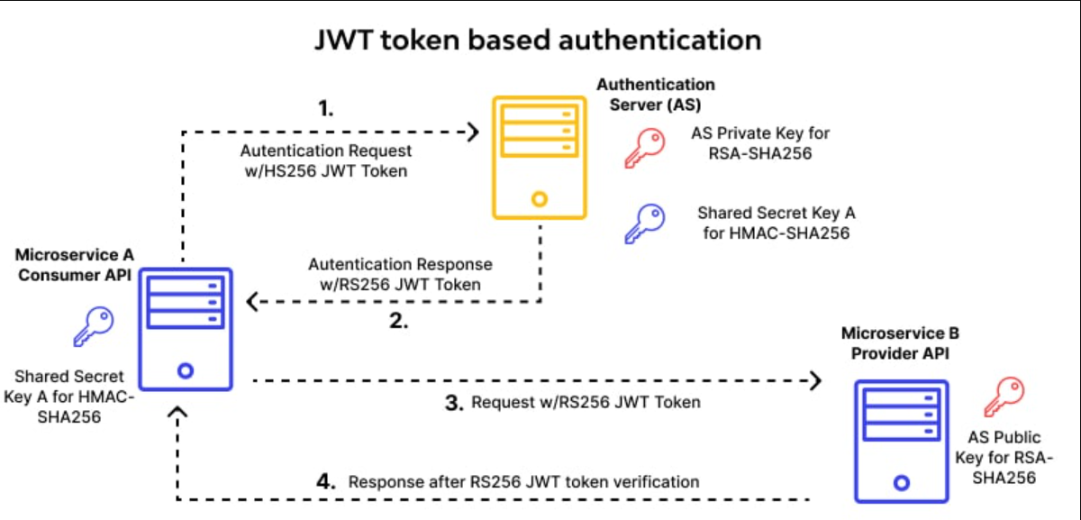

Slide 14
Biometric Authentication
Fingerprint scanners, facial recognition, iris scans
Mobile Phones
Hard to replicate, user-friendly
Privacy concerns, potential for false positives/negatives

Slide 15
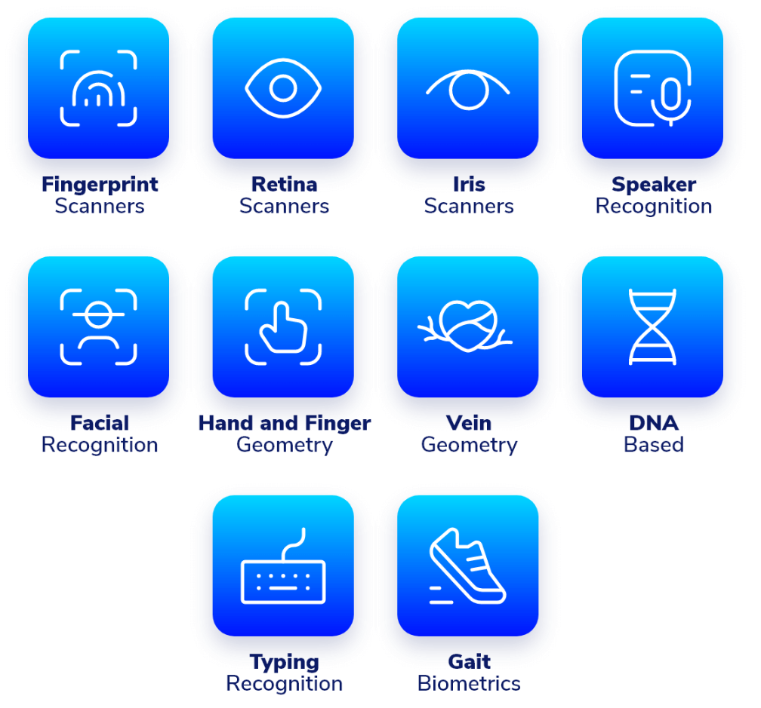

Slide 16
OAuth and OpenID Connect
OAuth
An open standard for access delegation, commonly used for token-based authentication.
OpenID Connect
An identity layer on top of OAuth 2.0 for verifying the identity of end-users
Secure, allows third-party authentication
Requires integration with third-party providers

Slide 17
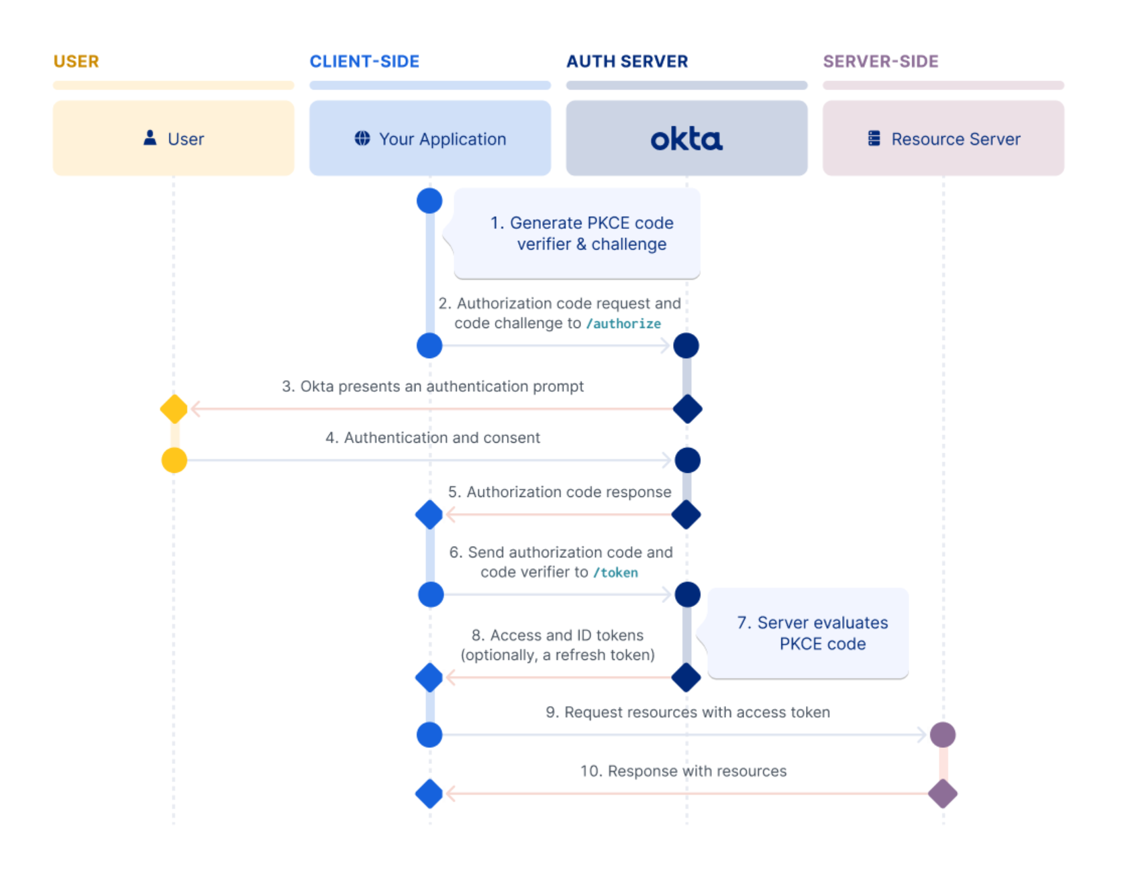

Slide 18
Authentication Challenges
Phishing Attacks
Brute Force Attacks
Man-in-the-Middle Attacks
Credential Stuffing

Slide 19
Improving Authentication Security
Strong Password Policies
Use MFA
Educate Users
Monitor and Respond

Slide 20
Authorization
Authorization is the process of determining if a user has the right to access a resource or perform an action
Ensures security by granting or restricting access based on permissions
Key Concepts
Permissions (Specific rights granted to a user or group to perform actions)
Roles (A collection of permissions grouped together, assigned to users)
Principals (The entity requesting access to resources)

Slide 21
Authorization Models
Discretionary Access Control (DAC)
Owners decide who has access to their resources
Mandatory Access Control (MAC)
Access is based on fixed policies set by a central authority
Role-Based Access Control (RBAC)
Access is based on the roles assigned to users
Attribute-Based Access Control (ABAC)
Access decisions are based on user attributes, resource attributes, and environmental conditions
Policy-Based Access Control (PBAC)
Uses policies to determine access

Slide 22
Best Practices
Principle of Least Privilege
Grant the minimum necessary permissions
Regular Audits
Logging and Monitoring

Slide 23
.NET Authorization & Authentication
Identity framework
https://learn.microsoft.com/en-us/aspnet/core/security/authentication/identity?view=aspnetcore-8.0&tabs=visual-studio
Cookie Authentication
UserManager
SignInManager

Slide 24
Identity framework
Microsoft Identity Framework is a comprehensive framework for managing user authentication and authorization
Key Features
User registration and login
Password management
Role-based and claims-based authorization
Two-factor authentication (2FA)
External login providers

Slide 25
Core Components of Microsoft Identity Framework
UserManager
Manages user accounts and operations
Provides methods for creating, updating, deleting users, and managing user roles and claims
SignInManager
Manages user sign-in and sign-out processes
Handles password sign-in, external logins, and two-factor authentication
RoleManager
Manages user roles and role-related operations
Provides methods for creating, updating, deleting roles, and assigning roles to users

Slide 26
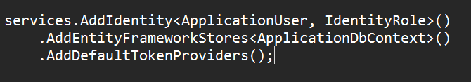
Setting Up Identity in ASP.NET Core
Installation
Configuration

Slide 27
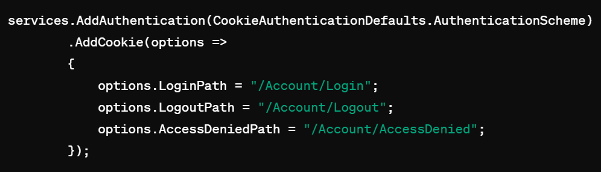
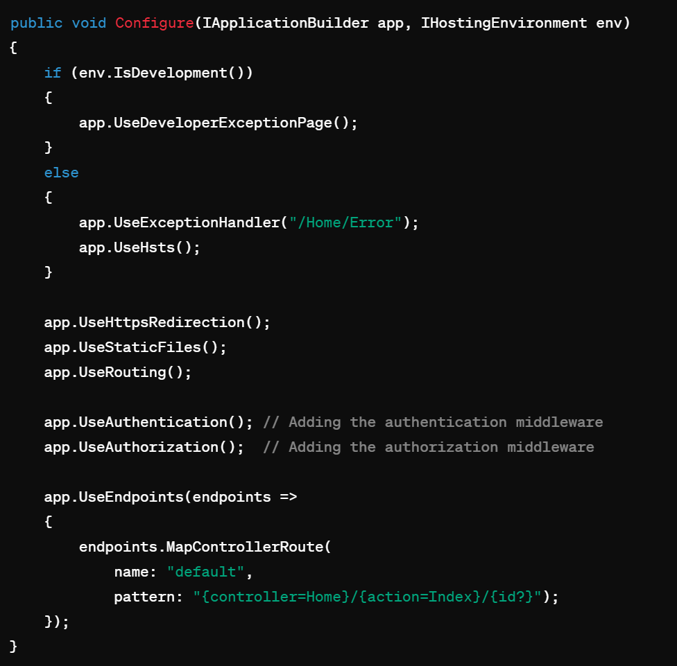
.NET Authorization & Authentication

Slide 28
QA

Slide 29
Thank you

